Slide 1
MODULE 4
CHAPTER 8
BAYESIAN LEARNING

Slide 2
INTRODUCTION TO PROBABILITY-BASED LEARNING
Probability-based learning is one of the most important practical learning methods which combines prior knowledge or prior probabilities with observed data.
Example:-
Suppose in a hospital dataset:
70% patients do not have a disease.
30% patients have the disease.
This information is prior knowledge.
When we test a new patient and get medical data, the model combines prior knowledge + new data to predict the result.

Slide 3
INTRODUCTION TO PROBABILITY-BASED LEARNING
Probabilistic learning uses the concept of probability theory that describes how to model randomness, uncertainty, and noise to predict future events.
In real-world data there are many uncertainties:
Randomness → unpredictable variation in data
Uncertainty → we do not know exact outcomes
Noise → incorrect or extra data that affects results
Probability theory helps models handle these problems.
Example
In email spam detection:
Some spam emails look like normal emails.
Some normal emails look like spam.
The probabilistic model calculates the probability that an email is spam.

Slide 4
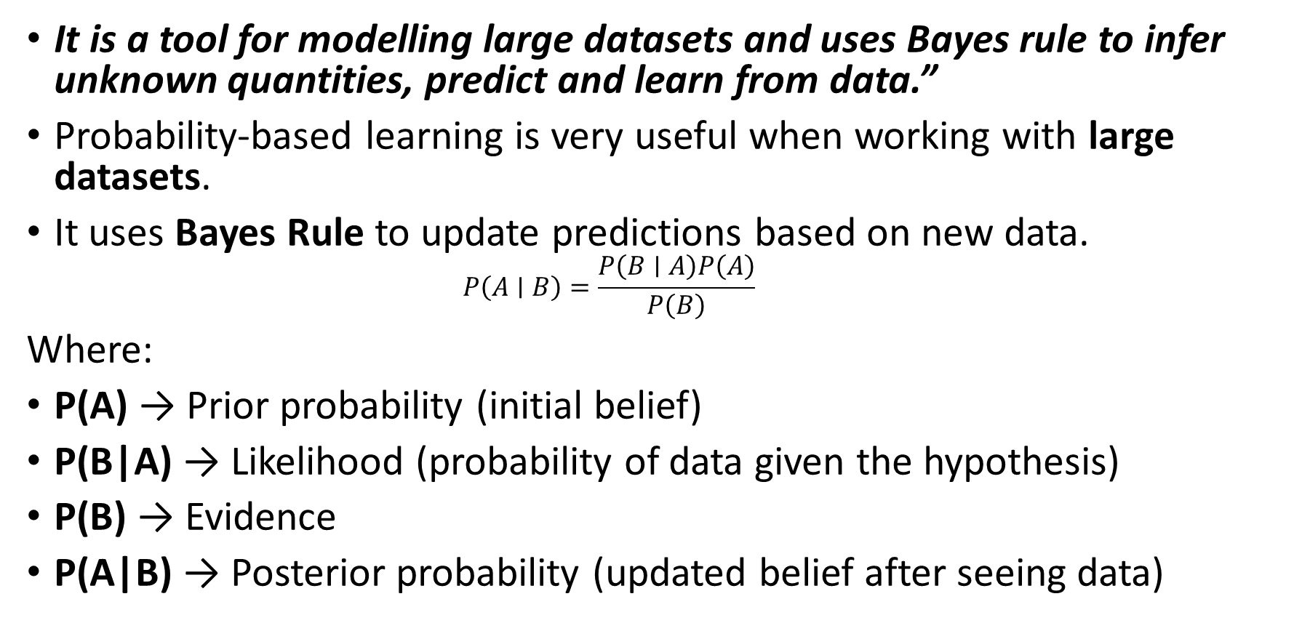
INTRODUCTION TO PROBABILITY-BASED LEARNING
It is a tool for modelling large datasets and uses Bayes rule to infer unknown quantities, predict and learn from data.”
Probability-based learning is very useful when working with large datasets.
It uses Bayes Rule to update predictions based on new data.
                $$P\left(A∣B\right)=\frac{P\left(B∣A\right)P\left(A\right)}{P\left(B\right)}$$
Where:
P(A) → Prior probability (initial belief)
P(B|A) → Likelihood (probability of data given the hypothesis)
P(B) → Evidence
P(A|B) → Posterior probability (updated belief after seeing data)

Slide 5
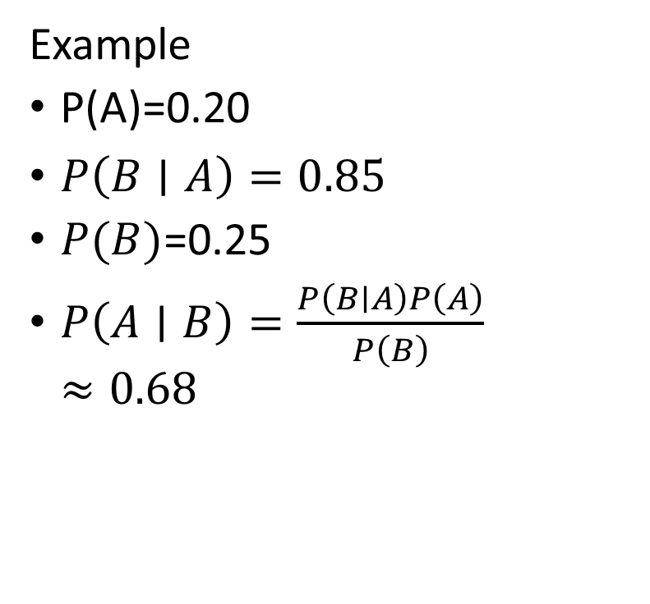
INTRODUCTION TO PROBABILITY-BASED LEARNING
Example
Example: Disease Prediction
P(Disease) → chance of having disease before test
P(Test|Disease) → probability that test is positive if disease exists
P(Disease|Test) → final probability of disease after seeing test result
Example
P(A)=0.20
$P\left(B∣A\right)=0.85$
$P(B)$=0.25
$P\left(A∣B\right)=\frac{P\left(B∣A\right)P\left(A\right)}{P\left(B\right)}≈0.68$

Slide 6
INTRODUCTION TO PROBABILITY-BASED LEARNING
Probabilistic Learning
Uses probability to make predictions
Combines old knowledge + new data
Handles uncertainty and noisy data
Uses Bayes Rule to update predictions

Slide 7
Probabilistic Model
In a probabilistic model, randomness plays a major role which gives probability distribution a solution, while in a deterministic model there is no randomness and hence it exhibits the same initial conditions every time the model is run and is likely to get a single possible outcome as the solution
In a probabilistic model, randomness exists.
The output is given as a probability distribution.
Different runs may give different results.
Example: Predicting rain with 70% probability.

Slide 8
Deterministic Model
In a deterministic model, no randomness is involved.
The same input always gives the same output.
Only one fixed result is produced.
Example: Mathematical formula 2 + 2 = 4.

Slide 9
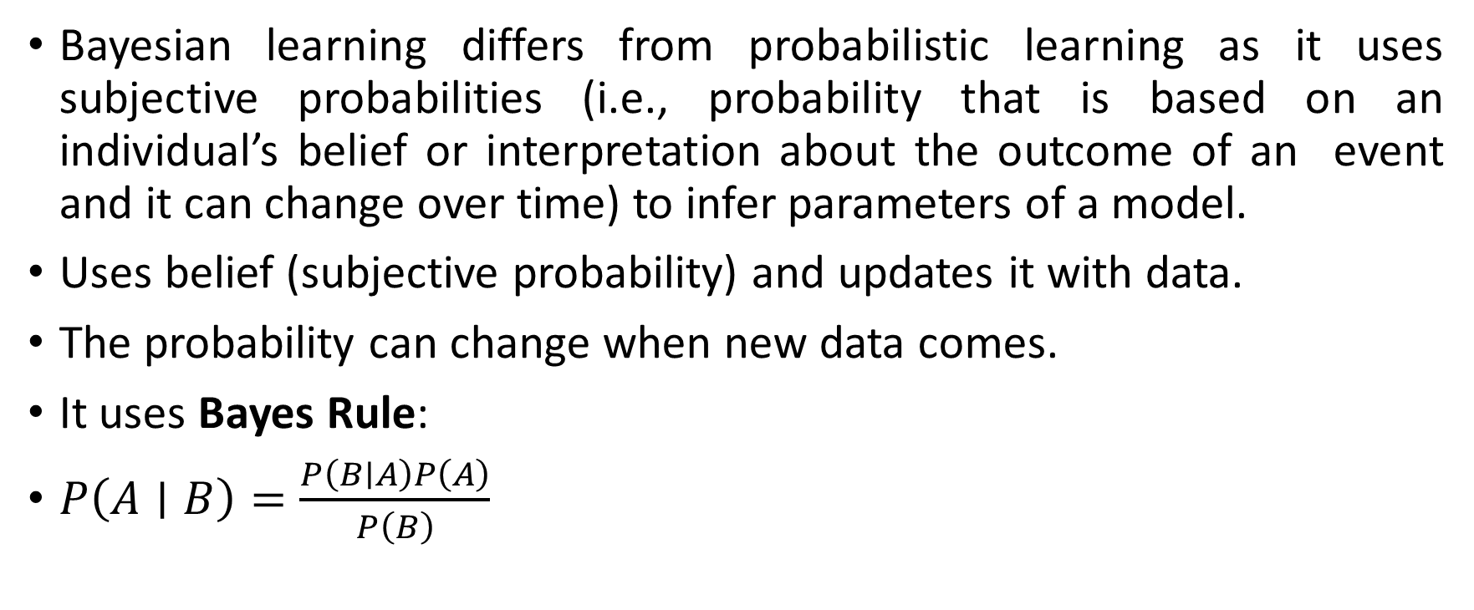
Bayesian Learning
Bayesian learning differs from probabilistic learning as it uses subjective probabilities (i.e., probability that is based on an individual’s belief or interpretation about the outcome of an event and it can change over time) to infer parameters of a model.
Uses belief (subjective probability) and updates it with data.
The probability can change when new data comes.
It uses Bayes Rule:
$P\left(A∣B\right)=\frac{P\left(B∣A\right)P\left(A\right)}{P\left(B\right)}$

Slide 10
Algorithms in Bayesian Learning
Two important algorithms are:
Naïve Bayes
Bayesian Belief Network (BBN)
Both use prior probability + data to make predictions.

Slide 11
Algorithms in Bayesian Learning
Two important algorithms are:
Naïve Bayes
Bayesian Belief Network (BBN)
Both use prior probability + data to make predictions.
Probabilistic models use randomness, deterministic models give fixed results, and Bayesian learning updates predictions using probability and Bayes rule.

Slide 12
Application
Bayesian inference is used in many fields such as:
Game theory
Medicine (disease diagnosis)
Machine learning prediction

Slide 13
Advantage
Works well even with missing data
Helps estimate uncertainty in predictions
Improves prediction as more data is added
Bayesian learning uses probability and Bayes theorem to make predictions and handle uncertainty in data.

Slide 14
Prior Probability
Prior probability is the probability of an event before seeing any new data or information.
Example:
In a dataset of emails:
60% emails are not spam
40% emails are spam
These probabilities are called prior probabilities.

Slide 15
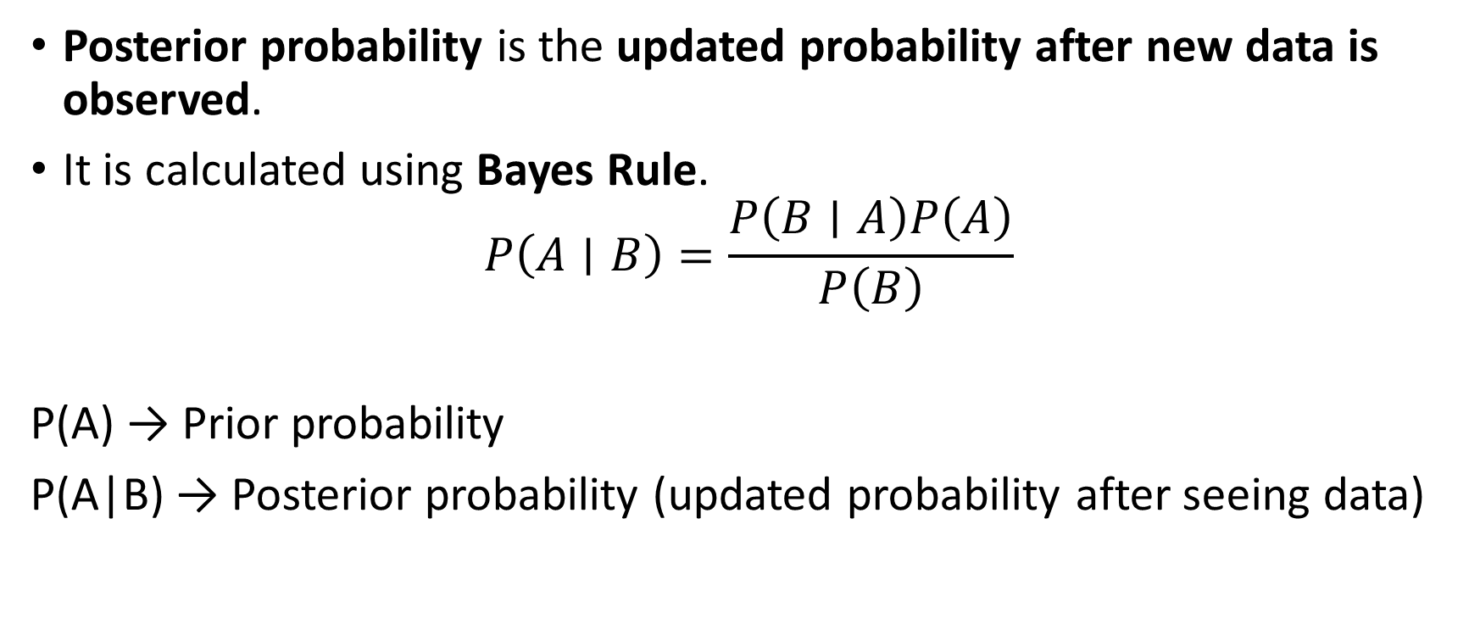
Posterior Probability
Posterior probability is the updated probability after new data is observed.
It is calculated using Bayes Rule.
$$P\left(A∣B\right)=\frac{P\left(B∣A\right)P\left(A\right)}{P\left(B\right)}$$
P(A) → Prior probability
P(A|B) → Posterior probability (updated probability after seeing data)

Slide 16
Prior Probability
In the Naïve Bayes algorithm, prior probability means:
The probability of each class before observing features or characteristics.
Example (Spam Detection):
P(Spam) = 0.4
P(Not Spam) = 0.6
These are prior probabilities.

Slide 17
Prior Probability in Naïve Bayes Algorithm
In the Naïve Bayes algorithm, prior probability means:
The probability of each class before observing features or characteristics.
Example (Spam Detection):
P(Spam) = 0.4
P(Not Spam) = 0.6
These are prior probabilities.
Posterior probability is obtained by updating prior probability with new data.
Posterior Probability = Prior Probability + New Data

Slide 18
Prior probability is the initial belief about an event, and posterior probability is the updated belief after observing new data.

Slide 19
Likelihood Probability in Machine Learning
In simple words, as the name suggests, the likelihood is a function that tells us how likely the specific data point suits the existing data distribution.
Suppose we are predicting whether a fruit is an Apple or Orange based on color.
Dataset observation:
Apples are mostly red
Oranges are mostly orange
Now a new fruit appears and its color is red.
Likelihood that the fruit is Apple → High
Likelihood that the fruit is Orange → Low
So the likelihood of the first class (Apple) is greater than the second class (Orange).

Slide 20
Examples of Probability and Likelihood
Examples of Probability and Likelihood
Examples 1 – Coin Toss
In the context of coin tosses, likelihood and probability represent different aspects of the same experiment.
The likelihood refers to the probability of observing a specific outcome given a particular model or hypothesis.
On the other hand, probability represents the long-term frequency of an event occurring over multiple trials.

Slide 21
Examples of Probability and Likelihood
To recap: probability is generally something we consider when we have a model with a fixed set of parameters and we are interested in the types of data that might be generated.
Conversely, likelihood comes into play when we have already observed data and we want to examine how likely certain model parameters are.
The distinction between probability and likelihood is fundamentally important: Probability attaches to possible results; likelihood attaches to hypotheses.

Slide 22
What is Probability?
Probability is a measure of the likelihood that an event will actually occur based on information or assumptions that are currently known.
The probability of the event is commonly stated as a number between 0 and 1, where 0 indicates impossibility and 1 indicates inevitability.
To determine probability, use the following formula −
Probability=Number of favorable outcomes/Total number of outcomes
For instance, the probability of getting heads when flipping a fair coin is 0.5 because there are two possible outcomes (heads or tails), and each outcome has an equal likelihood of occurring.
Probability is used to describe the likelihood of events based on assumptions or to make predictions about the future.

Slide 23
What is Probability?
Probability is used to make predictions about future events, whereas likelihood is used to estimate unknown parameters based on seen evidence.

Slide 24
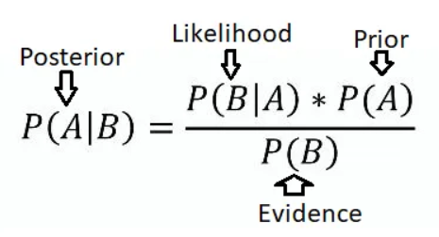

Slide 25
FUNDAMENTALS OF BAYES THEOREM
The Naïve Bayes model is based on Bayes Theorem and uses three types of probabilities:
Prior Probability
Likelihood Probability
Posterior Probability

Slide 26
PRIOR PROBABILITY
Prior probability is the initial probability of an event before seeing any data or evidence.
It is the general belief about an event before collecting new information.
Example:
In an email dataset:
40% emails are Spam
60% emails are Not Spam
These are prior probabilities.

Slide 27
LIKELIHOOD PROBABILITY
Likelihood probability tells us how likely the evidence is for a given class or hypothesis.
It is written as:
P(Evidence | Hypothesis)
Meaning:
Probability of observing the data given a particular class.
Example:
If the word “offer” appears in an email:
Probability of word “offer” in Spam emails may be high.
So the likelihood of Spam increases.

Slide 28
POSTERIOR PROBABILITY
Posterior probability is the updated probability after considering the evidence or data.
It is written as:
P(Hypothesis | Evidence)
Meaning:
Probability of the class after observing the data.

Slide 29
POSTERIOR PROBABILITY
Relationship using Bayes Rule
P(H|E)=\frac{P(E|H)P(H)}{P(E)}
Where:
P(H) → Prior Probability
P(E|H) → Likelihood
P(H|E) → Posterior Probability
Prior → Initial belief
Likelihood → Probability of data given the hypothesis
Posterior → Updated belief after seeing the data

Slide 30
CLASSIFICATION USING BAYES MODEL
Naïve Bayes Classification models work on the principle of Bayes theorem.
Bayes’ rule is a mathematical formula used to determine the posterior probability, given prior probabilities of events.
Generally, Bayes theorem is used to select the most probable hypothesis from data, considering both prior knowledge and posterior distributions. It is based on the calculation of the posterior probability and is stated as:
P (Hypothesis h | Evidence E)
where, Hypothesis h is the target class to be classified and Evidence E is the given test instance.

Slide 31
P (Hypothesis h| Evidence E) is calculated from the prior probability P (Hypothesis h), the likelihood probability P (Evidence E |Hypothesis h) and the marginal probability P (Evidence E).
It can be written as:
where, P (Hypothesis h) is the prior probability of the hypothesis h without observing the training data or considering any evidence.
It denotes the prior belief or the initial probability that the hypothesis h is correct. P (Evidence E) is the prior probability of the evidence E from the training dataset without any knowledge of which hypothesis holds. It is also called the marginal probability.

Slide 32
P (Evidence E | Hypothesis h) is the prior probability of Evidence E given Hypothesis h.
It is the likelihood probability of the Evidence E after observing the training data that the hypothesis h is correct.
P (Hypothesis h | Evidence E) is the posterior probability of Hypothesis h given Evidence E.
It is the probability of the hypothesis h after observing the training data that the evidence E is correct.
In other words, by the equation of Bayes Eq. (8.1), one can observe that:
Posterior Probability α Prior Probability × Likelihood Probability

Slide 33
Bayes Theorem and MAP Hypothesis
Bayes Theorem helps us calculate the posterior probability for different hypotheses.
A hypothesis is a possible explanation or prediction.
After calculating the probabilities, we choose the hypothesis with the highest probability.
This method is called Maximum A Posteriori (MAP) Hypothesis.

Slide 34
MAP Hypothesis
MAP means selecting the hypothesis that has the highest posterior probability after seeing the data.
It is written as:
MAP = \arg\max_{H} P(H|D)
Where:
H → Hypothesis
D → Observed data
P(H|D) → Posterior probability

Slide 35
MAP Hypothesis
Example
Suppose a classifier predicts whether an email is Spam or Not Spam.
After applying Bayes theorem:
P(Spam | Email) = 0.8
P(Not Spam | Email) = 0.2
Since 0.8 is higher, the MAP hypothesis = Spam.
MAP hypothesis selects the hypothesis with the highest posterior probability using Bayes theorem.

Slide 36
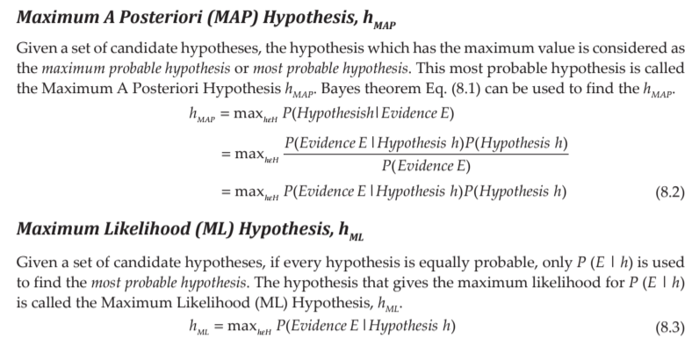

Slide 37
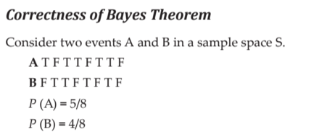
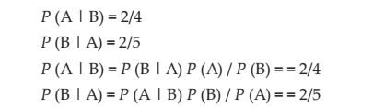

Slide 38
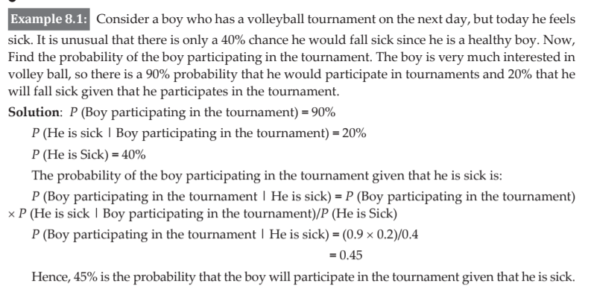

Slide 39
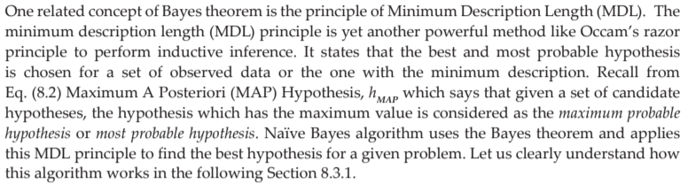

Slide 40
What is Naive Bayes Classifier?
Naive Bayes classifier is a probabilistic machine learning model based on Bayes’ theorem. It assumes independence between features and calculates the probability of a given input belonging to a particular class. It’s widely used in text classification, spam filtering, and recommendation systems.

Slide 41
NAÏVE BAYES ALGORITHM
It is a supervised binary class or multi class classification algorithm that works on the principle of Bayes theorem.
There is a family of Naïve Bayes classifiers based on a common principle.
These algorithms classify for datasets whose features are independent and each feature is assumed to be given equal weightage.
It particularly works for a large dataset and is very fast. It is one of the most effective and simple classification algorithms.
This algorithm considers all features to be independent of each other even though they are individually dependent on the classified object.
Each of the features contributes a probability value independently during classification and hence this algorithm is called as Naïve algorithm. Some important applications of these algorithms are text classification, recommendation system and face recognition.

Slide 42
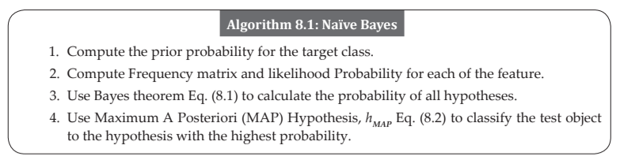
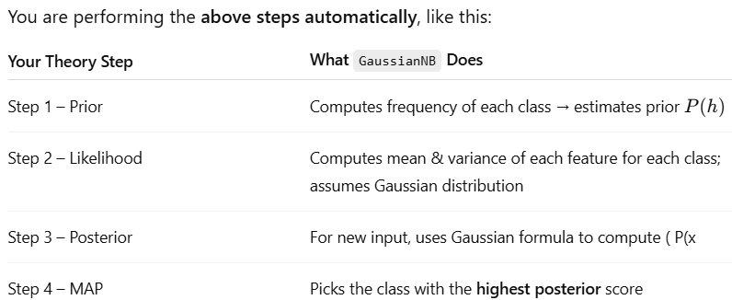

Slide 43
# Predict on test set
y_pred = nb_classifier.predict(X_test)
#It calculates posterior probabilities for each class and assigns the class with the highest one — that’s your MAP classifier in action.

Slide 44
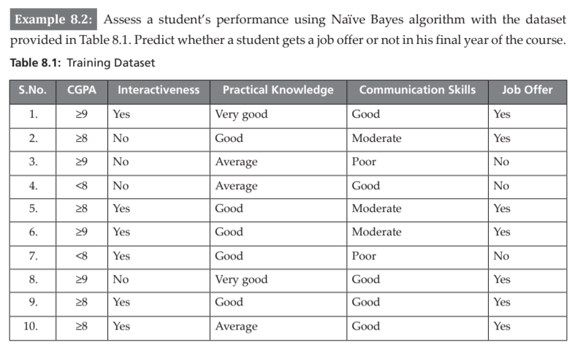

Slide 45
Solution: The training dataset T consists of 10 data instances with attributes such as ‘CGPA’, ‘Interactiveness’, ‘Practical Knowledge’ and ‘Communication Skills’ as shown in Table 8.1.
The target variable is Job Offer which is classified as Yes or No for a candidate student.
Step 1: Compute the prior probability for the target feature ‘Job Offer’. The target feature ‘Job Offer’ has two classes, ‘Yes’ and ‘No’.
It is a binary classification problem.
Given a student instance, we need to classify whether ‘Job Offer = Yes’ or ‘Job Offer = No’.
From the training dataset, we observe that the frequency or the number of instances with ‘Job Offer = Yes’ is 7 and ‘Job Offer = No’ is 3.

Slide 46
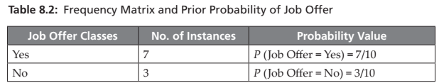
The prior probability for the target feature is calculated by dividing the number of instances belonging to a particular target class by the total number of instances.
Hence, the prior probability for ‘Job Offer = Yes’ is 7/10 and ‘Job Offer = No’ is 3/10 as shown in Table 8.2.

Slide 47
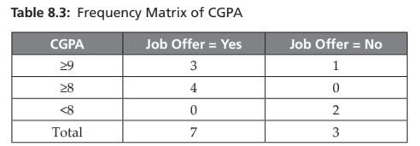
Step 2: Compute Frequency matrix and Likelihood Probability for each of the feature. Step 2(a): Feature – CGPA Table 8.3 shows the frequency matrix for the feature CGPA.

Slide 48
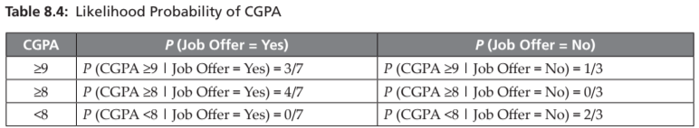
Table 8.4 shows how the likelihood probability is calculated for CGPA using conditional probability.

Slide 49
As explained earlier the Likelihood probability is stated as the sampling density for the evidence given the hypothesis.
It is denoted as P (Evidence | Hypothesis), which says how likely is the occurrence of the evidence given the parameters.
It is calculated as the number of instances of each attribute value and for a given class value divided by the number of instances with that class value.
For example P (CGPA ≥9 | Job Offer = Yes) denotes the number of instances with ‘CGPA ≥9’ and ‘Job Offer = Yes’ divided by the total number of instances with ‘Job Offer = Yes’.
From the Table 8.3 Frequency Matrix of CGPA, number of instances with ‘CGPA ≥9’ and ‘Job Offer = Yes’ is 3. The total number of instances with ‘Job Offer = Yes’ is 7. Hence, P (CGPA ≥9 | Job Offer = Yes) = 3/7.
Similarly, the Likelihood probability is calculated for all attribute values of feature CGPA.

Slide 50
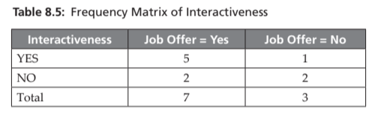
Step 2(b): Feature – Interactiveness Table 8.5 shows the frequency matrix for the feature Interactiveness.

Slide 51
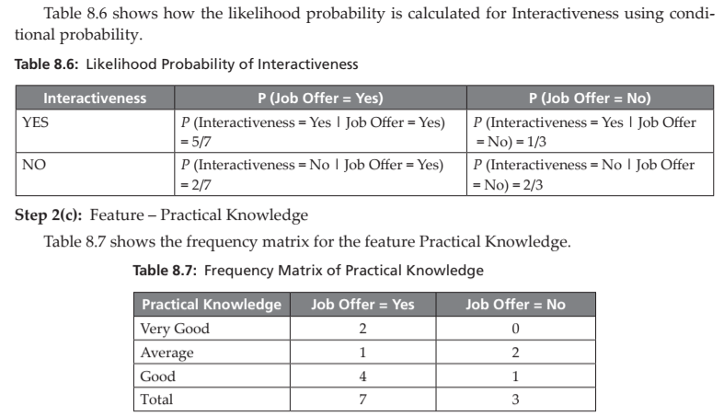

Slide 52
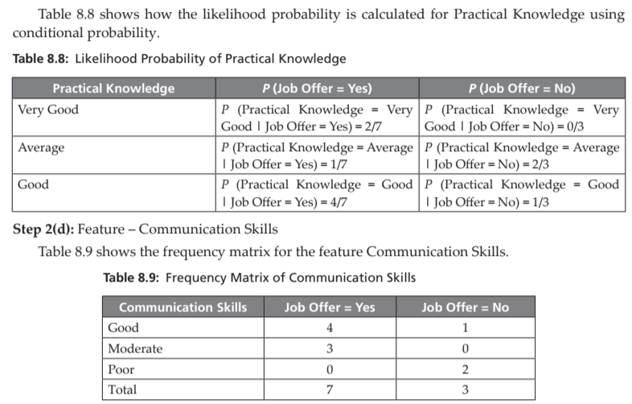

Slide 53
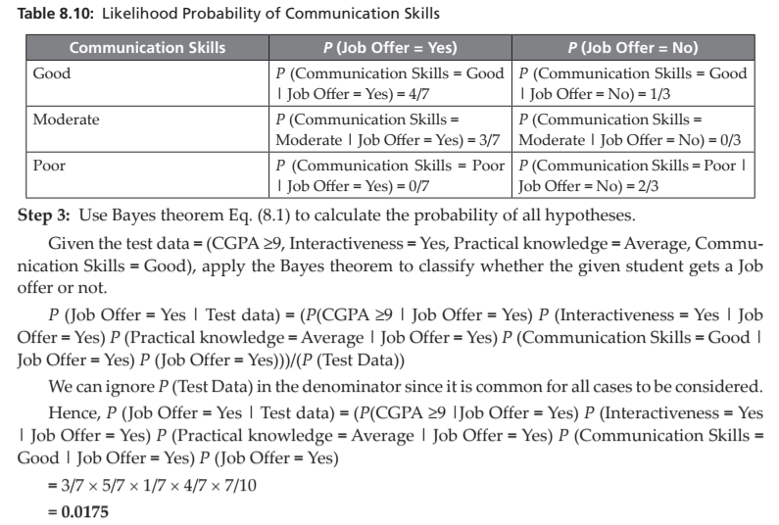

Slide 54
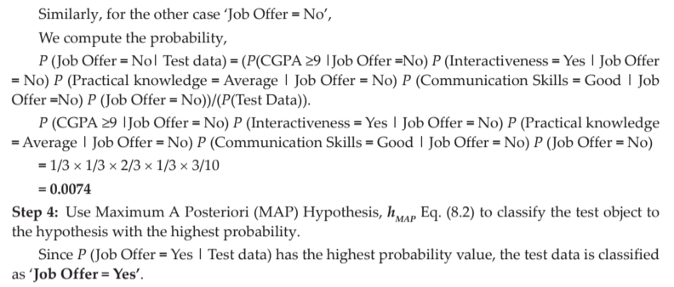

Slide 55
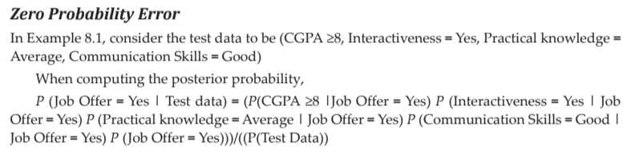
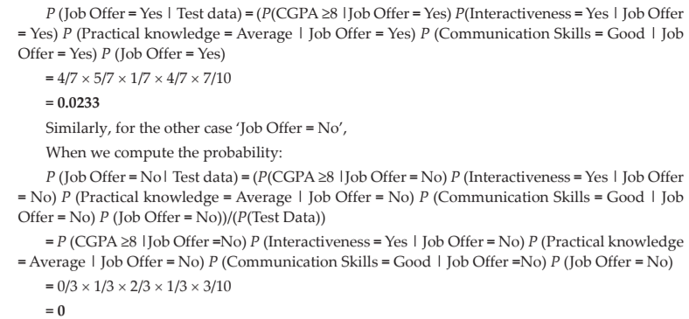

Slide 56
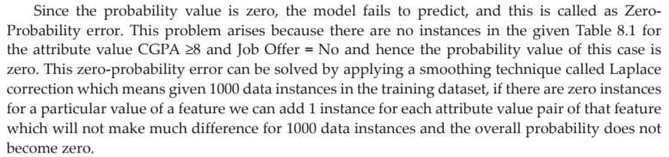

Slide 57
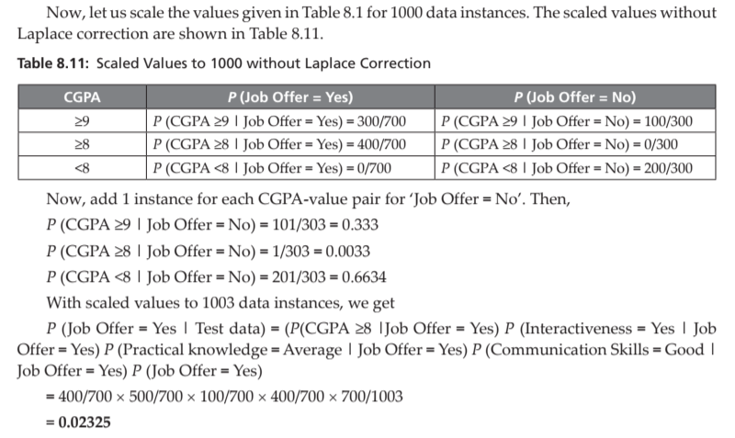

Slide 58
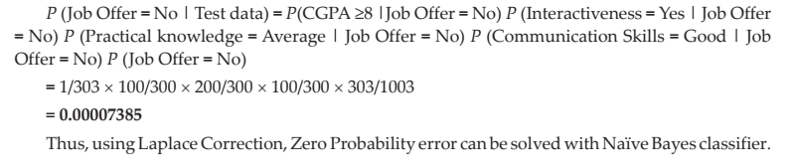

Slide 59
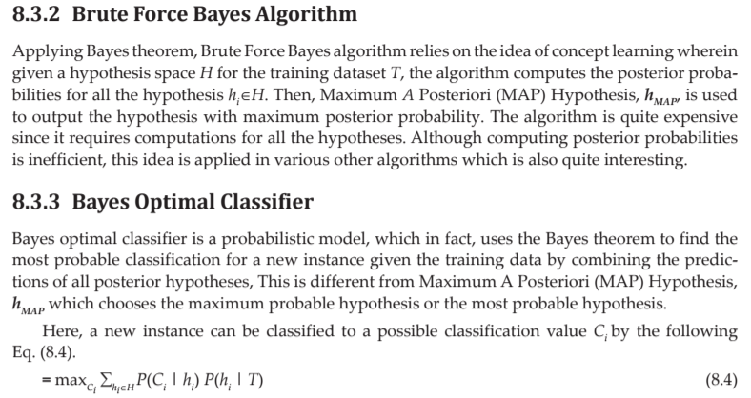

Slide 60
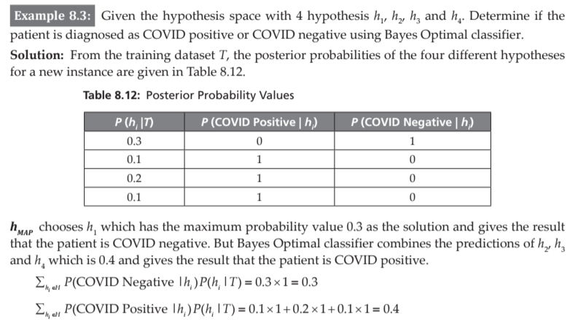


Slide 61
8.3.4 Gibbs Algorithm
The main drawback of Bayes optimal classifier is that it computes the posterior probability for all hypotheses in the hypothesis space and then combines the predictions to classify a new instance.
Gibbs algorithm is a sampling technique which randomly selects a hypothesis from the hypothesis space according to the posterior probability distribution and classifies a new instance.
It is found that the prediction error occurs twice with the Gibbs algorithm when compared to Bayes Optimal classifier.

Slide 62
8.4 NAÏVE BAYES ALGORITHM FOR CONTINUOUS ATTRIBUTES
There are two ways to predict with Naive Bayes algorithm for continuous attributes:
1. Discretize continuous feature to discrete feature.
2. Apply Normal or Gaussian distribution for continuous feature.
Gaussian Naive Bayes Algorithm In Gaussian Naive Bayes, the values of continuous features are assumed to be sampled from a Gaussian distribution.

Slide 63
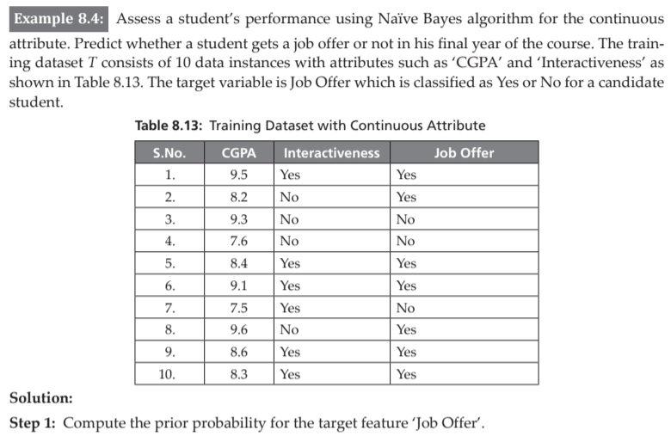

Slide 64
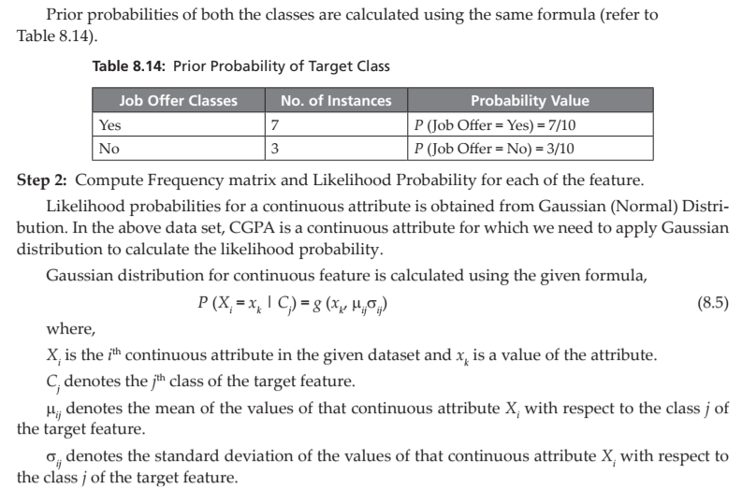

Slide 65
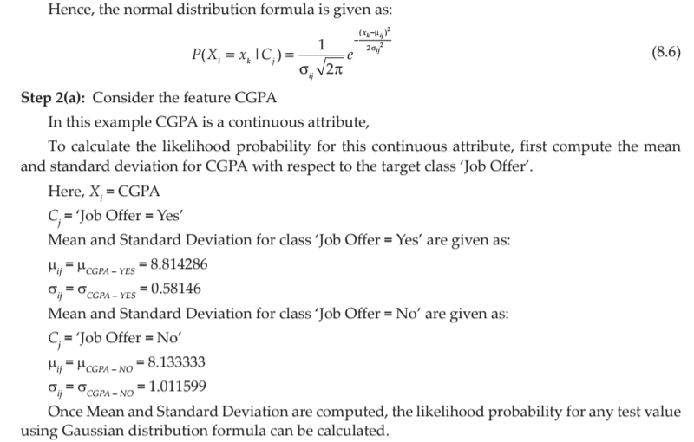

Slide 66
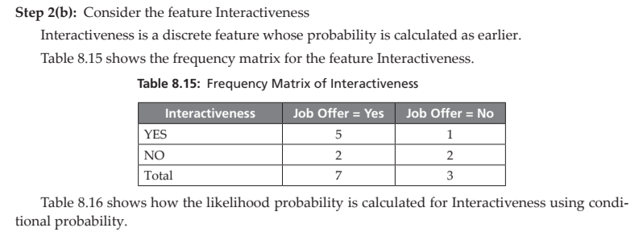

Slide 67
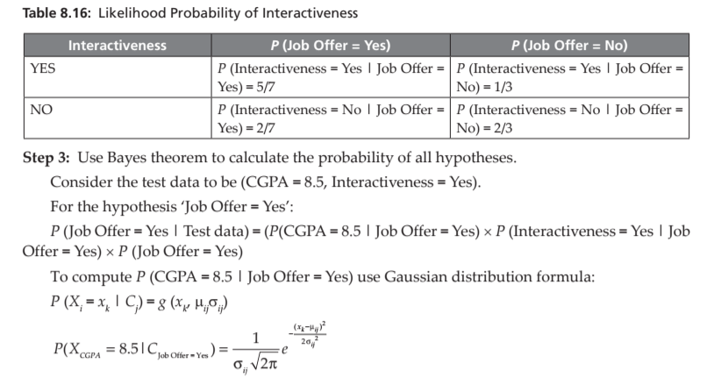

Slide 68
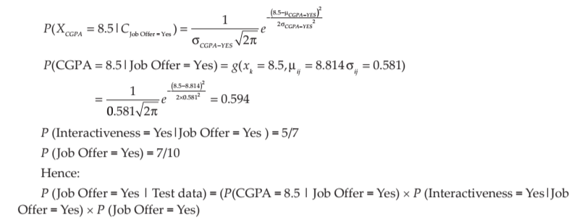

Slide 69
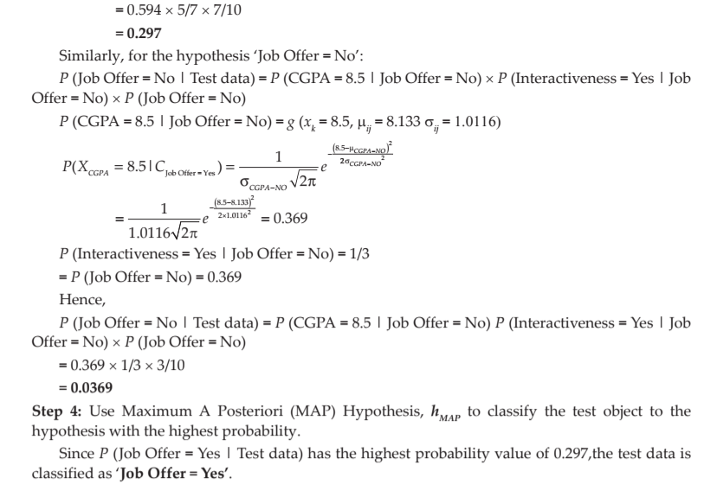

Slide 70
Thank You

